Slide 1



ClipMindAI
Video Summarization & Key Moments Detection Platform
Weeks 5 & 6 — Automated Video Intelligence, Timestamp Extraction, Keyword Workflows & Performance Insights

Slide 2






Executive Summary
Key Moments & Timestamps
Keyword Workflows
Analytics Dashboard
Automated timestamp extraction logic detects critical segments, chapters, and key highlights across video feeds instantly.
Advanced NLP models extract domain-specific key terms and concepts with high detection accuracy and quality ratings.
Comprehensive dashboard visualizing usage statistics, processing pipelines, storage metrics, and downloadable summary reports.

Slide 3
System Architecture
Audio Processing Pipeline: Transcribes audio into structured sentences with accurate word-level alignment.
AI Segment Classifier: Groups continuous video timestamps into meaningful topic chapters and key moments.
NLP Keyword Extractor: Evaluates vocabulary frequency and contextual relevance to yield top key terms.
Analytics & Reporting Engine: Aggregates video metrics, pipeline health, and summary insights into a consolidated UI.

Slide 4

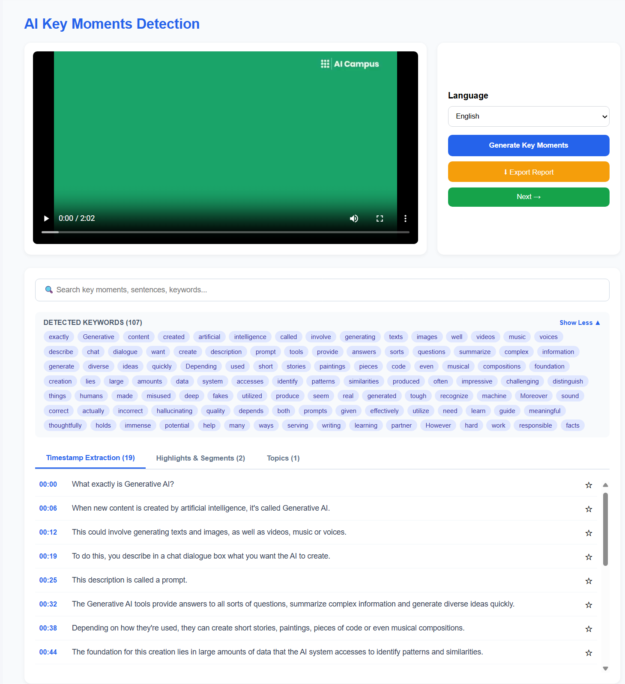
AI Timestamp Extraction
Automated Navigation: Maps key sentences directly to video timestamps (e.g., 00:00 - What is AI?).
Transcript Sync: Displays contextual transcripts aligned perfectly with media playback.
Detected Keywords Bar: Extracts and displays up to 31 active keywords per video segment.

Slide 5
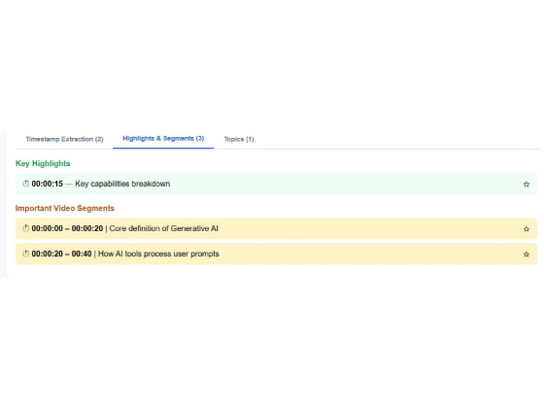
Important Video Segments
Key Highlights: Isolates single critical timestamps like capability breakdowns (e.g., 00:15).
Segment Ranges: Defines logical start and end windows (e.g., 00:00–00:20 | Core definition of Generative AI).
Interactive Bookmarks: Enables users to jump straight to relevant sections without manual searching.

Slide 6
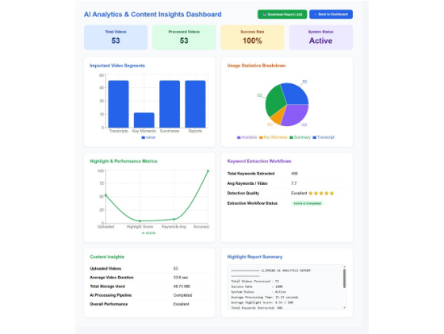
Analytics Dashboard
Centralized Monitor: Single view for system status, processing success rates, and storage usage.
Visual Analytics: Bar and pie chart breakdowns for transcripts, highlights, and summaries.
Report Generation: Real-time text report summary with one-click `.txt` download capability.

Slide 7
Thank You!
Milestone 3 — Key Moments Detection & Analytics Dashboard

